Slide 1
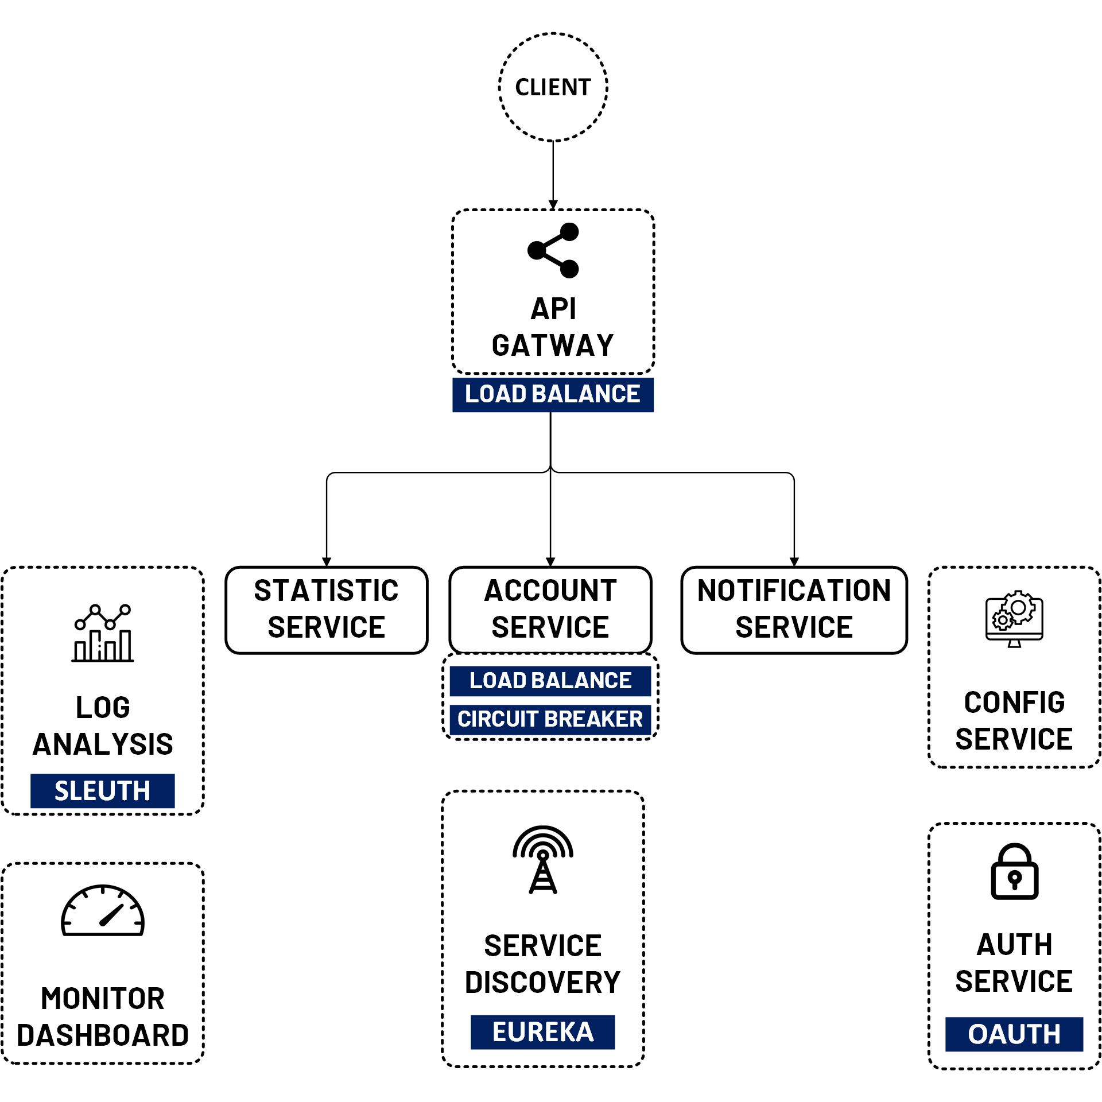

Spring Security OAuth2 Authorization Code (JWT Public, Private Keys)
www.jmaster.io/course/microservices-with-spring-cloud

